Slide 1
Kapija mog detinjstva!

Slide 2
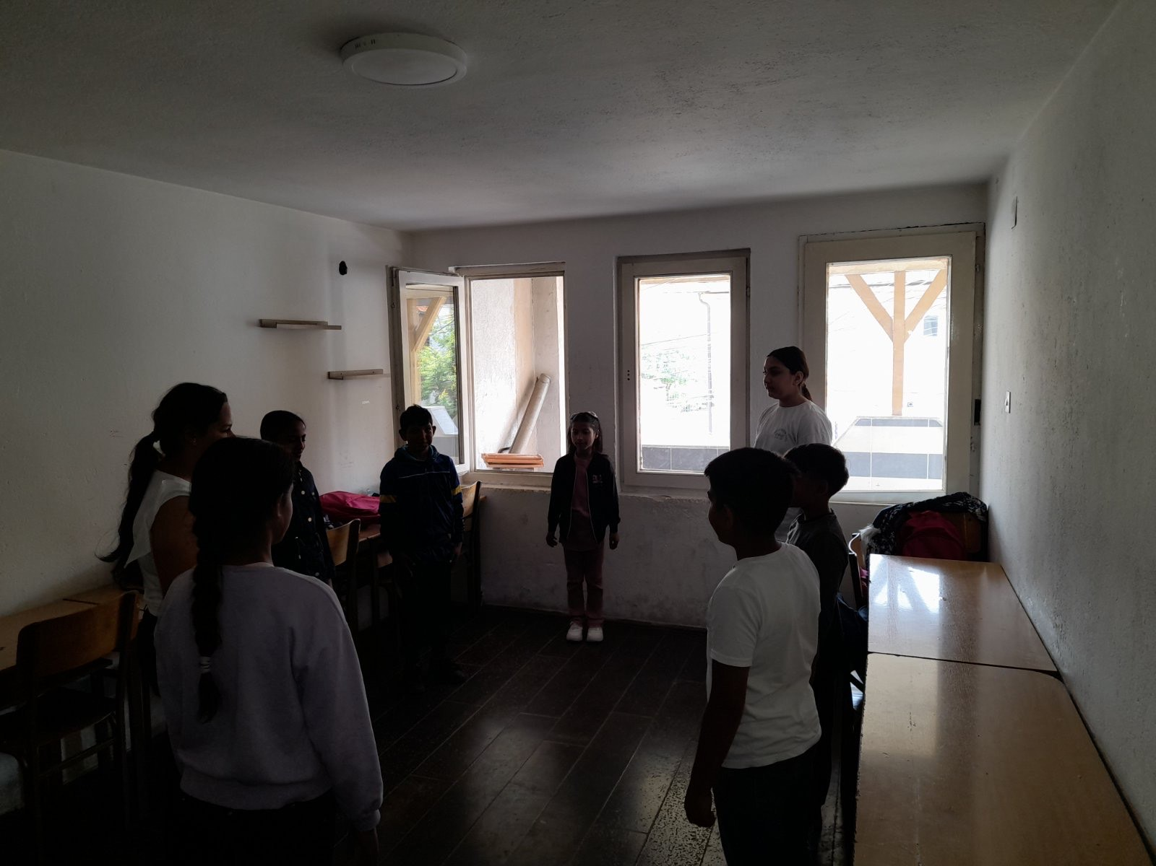
od ideje do realizacije:

Slide 3
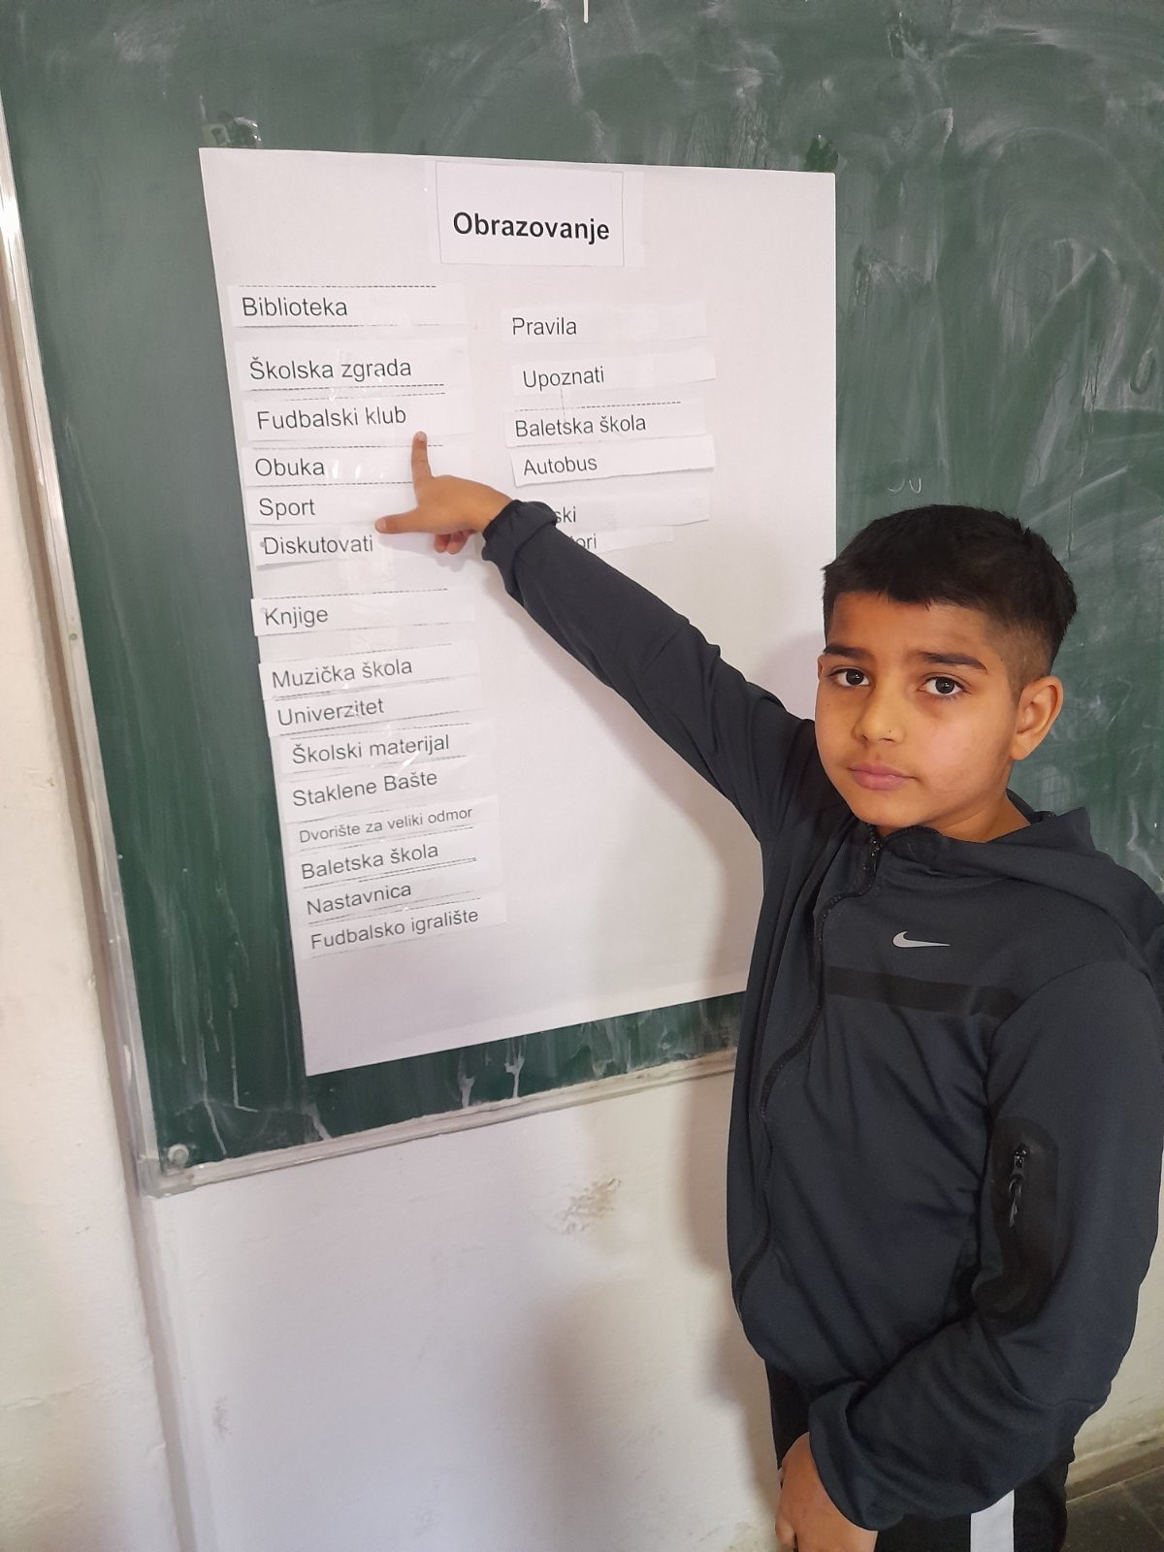
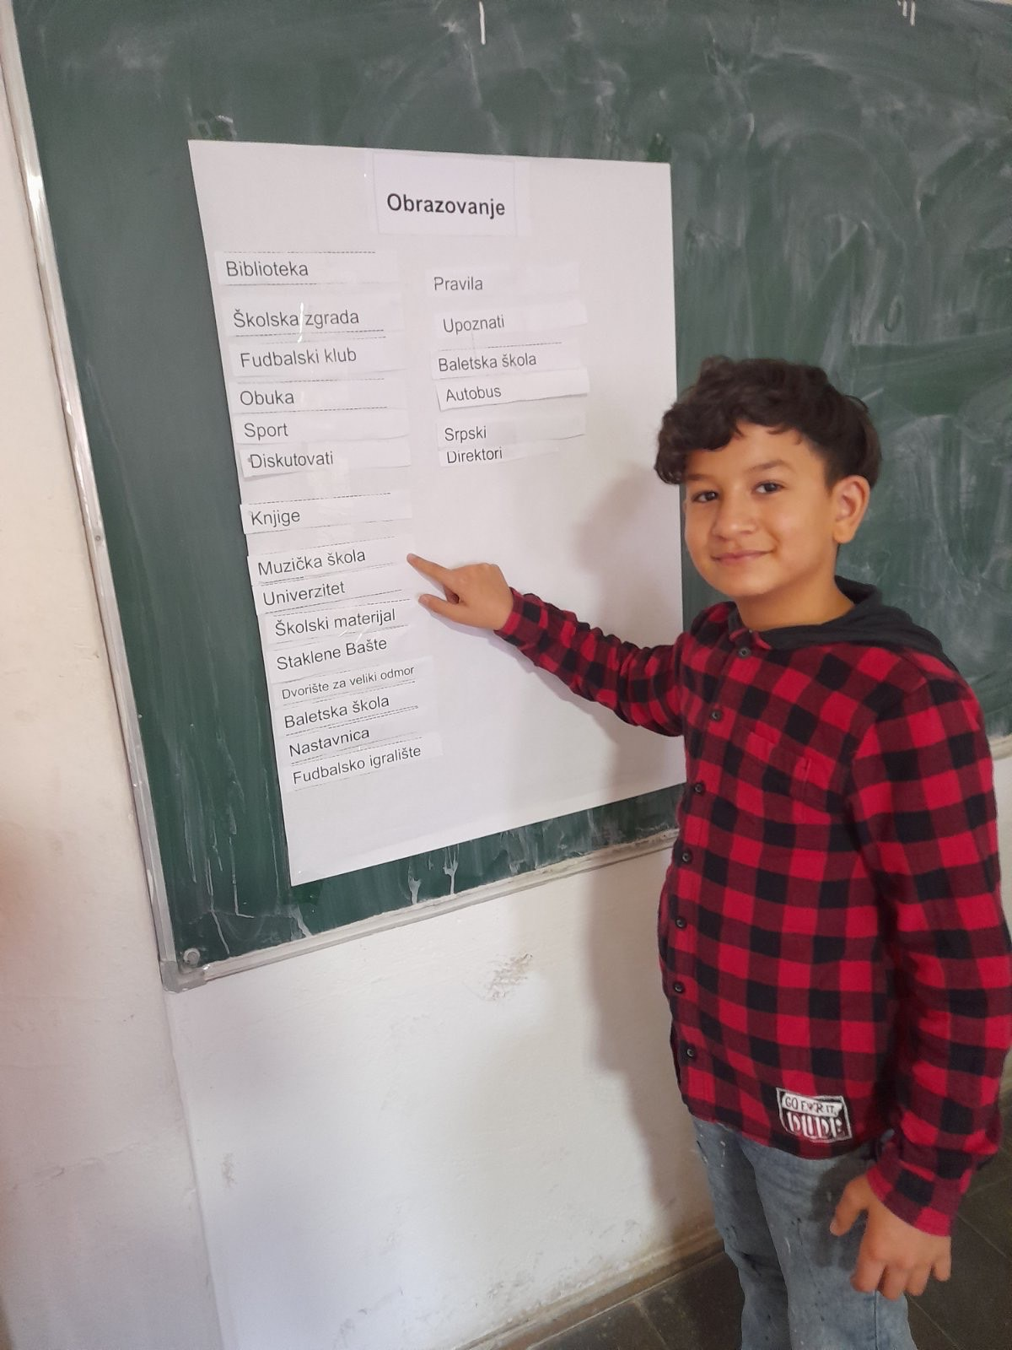
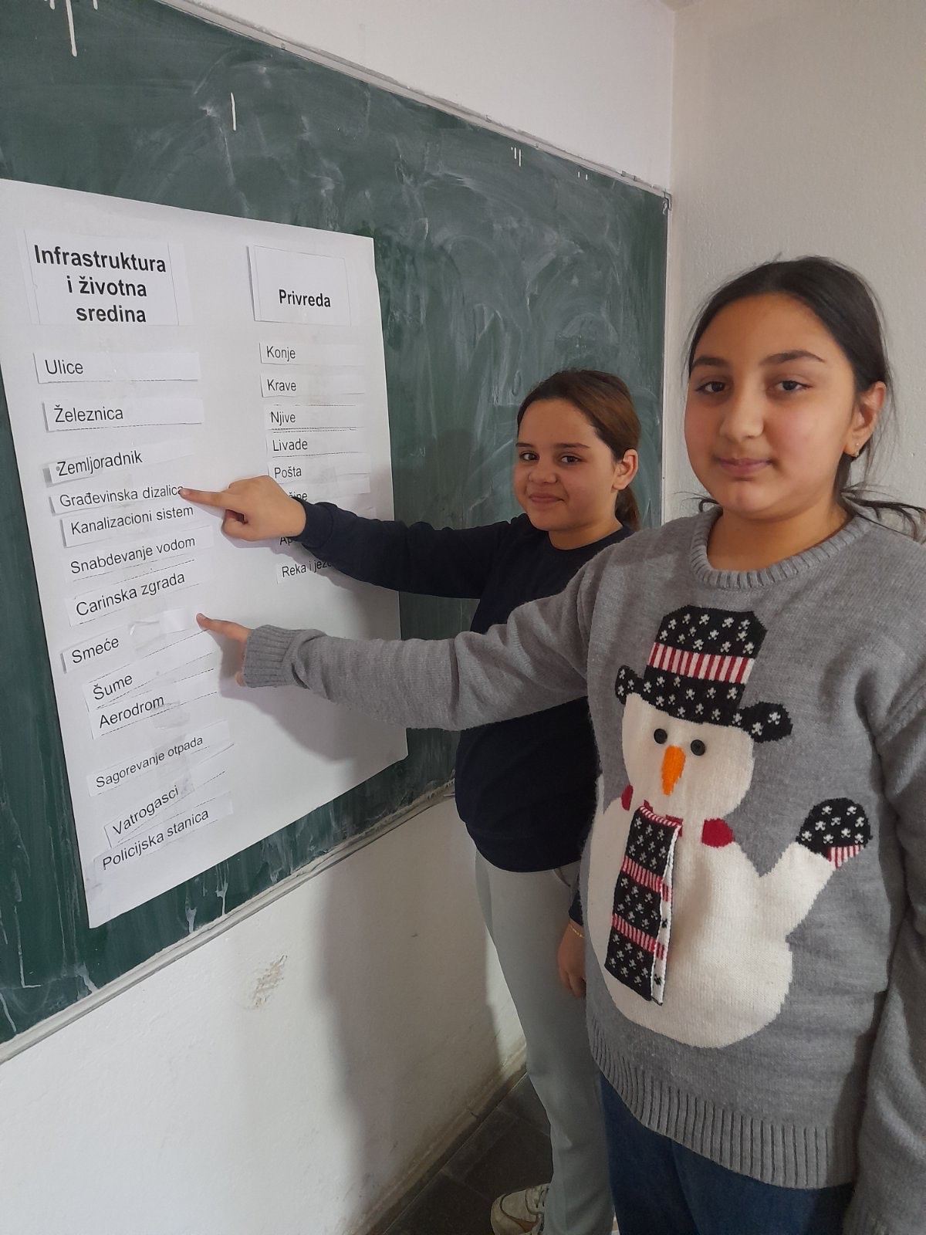
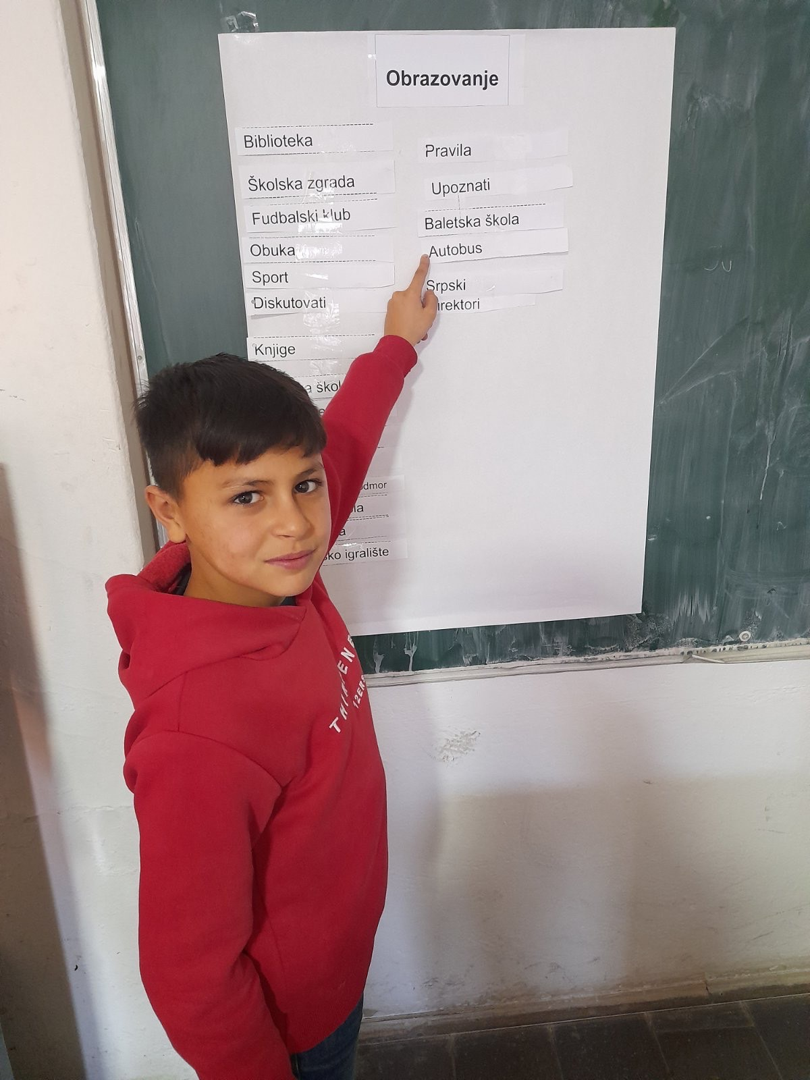
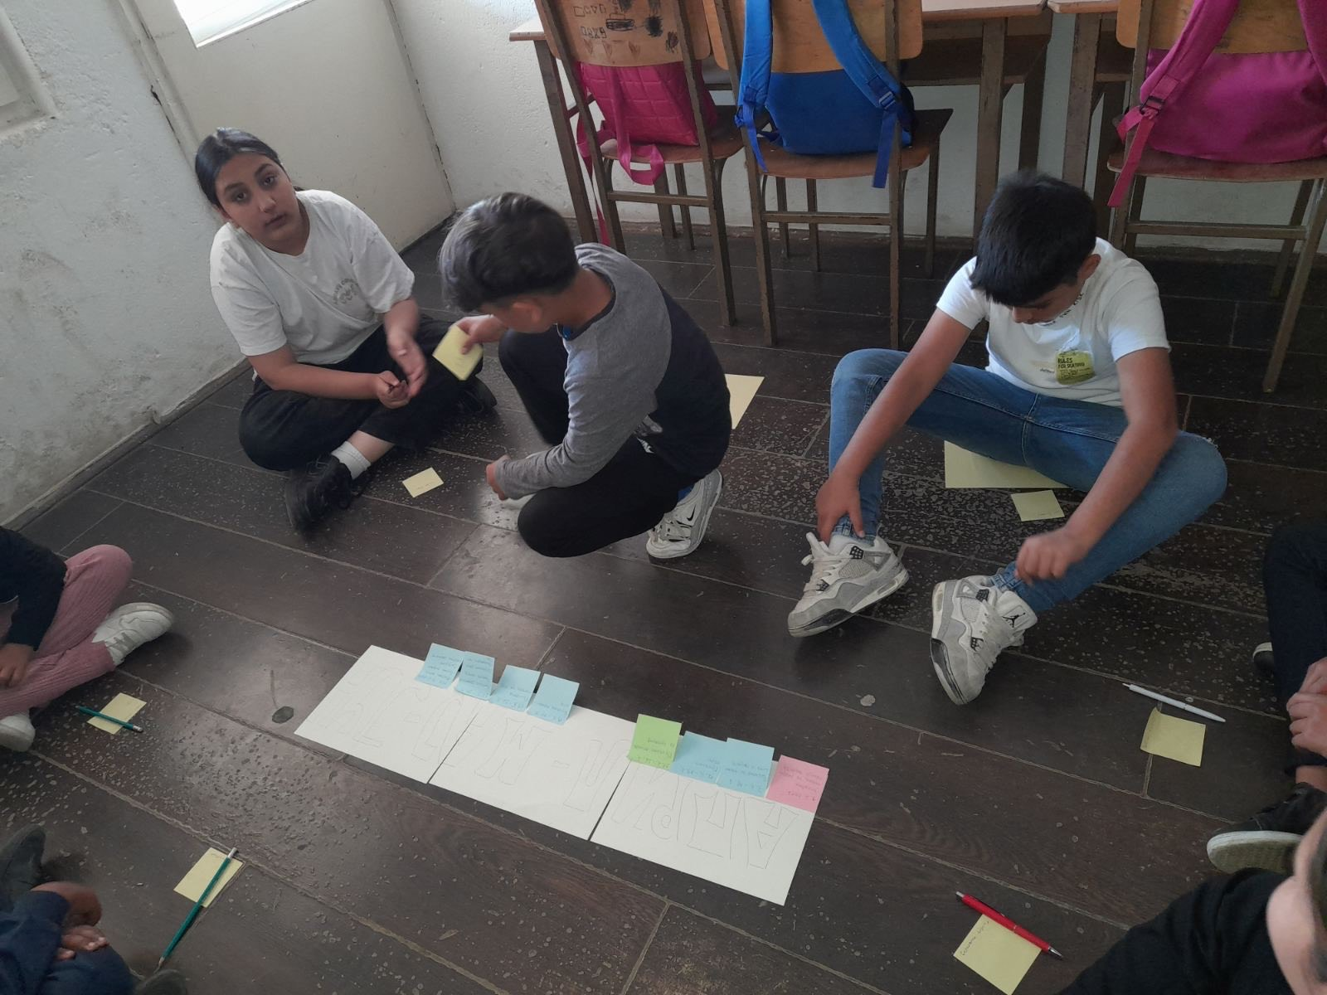
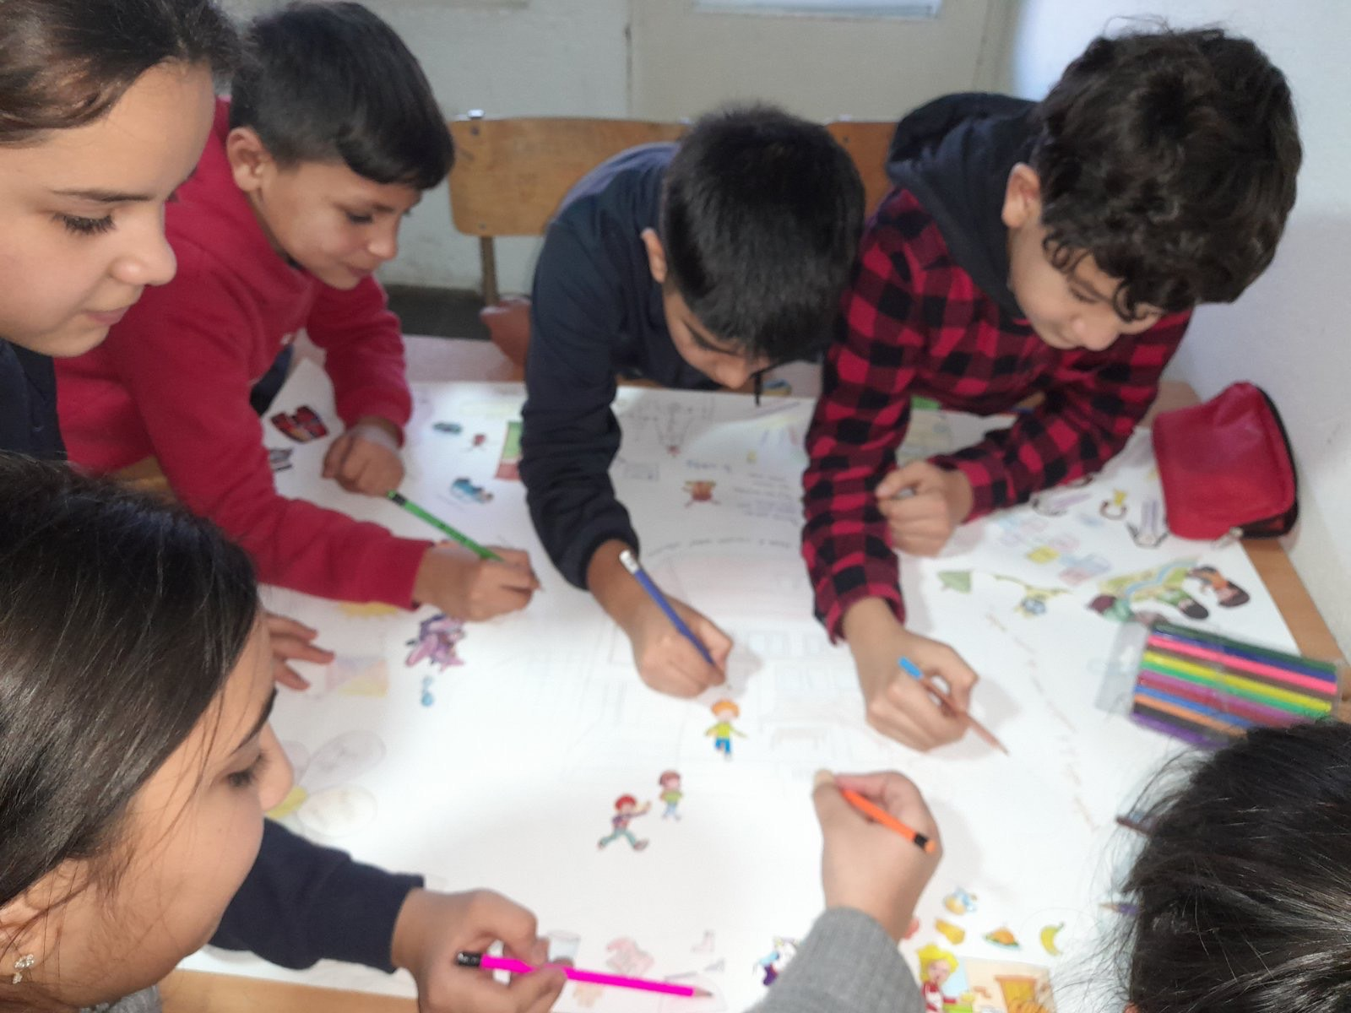

Slide 4
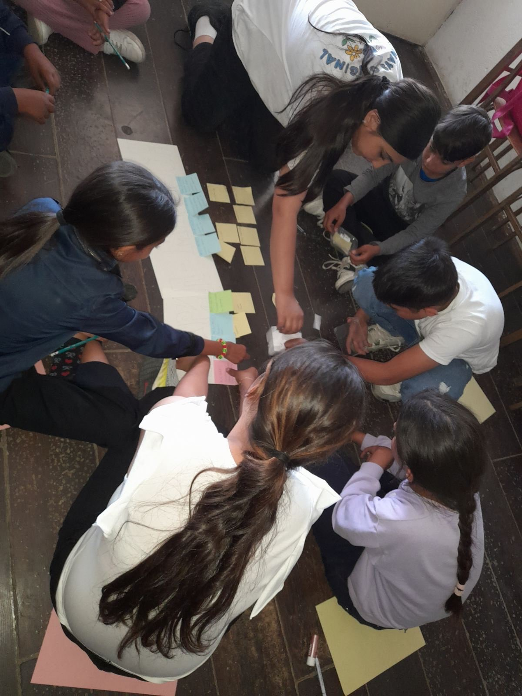
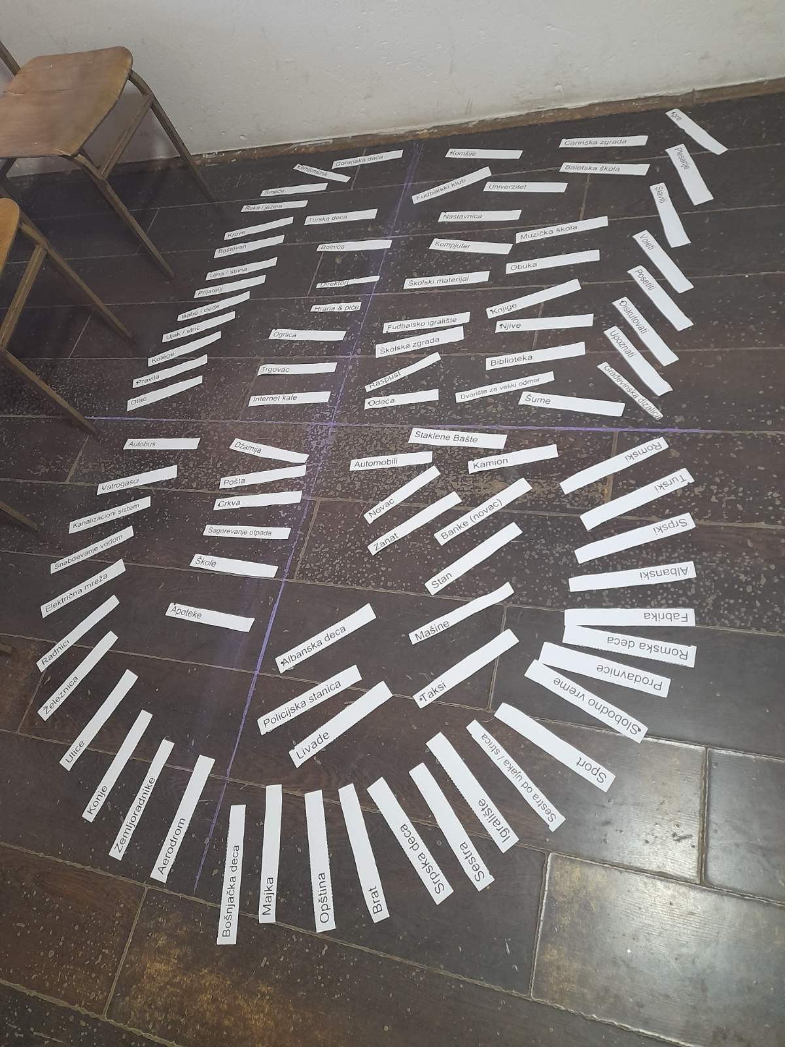
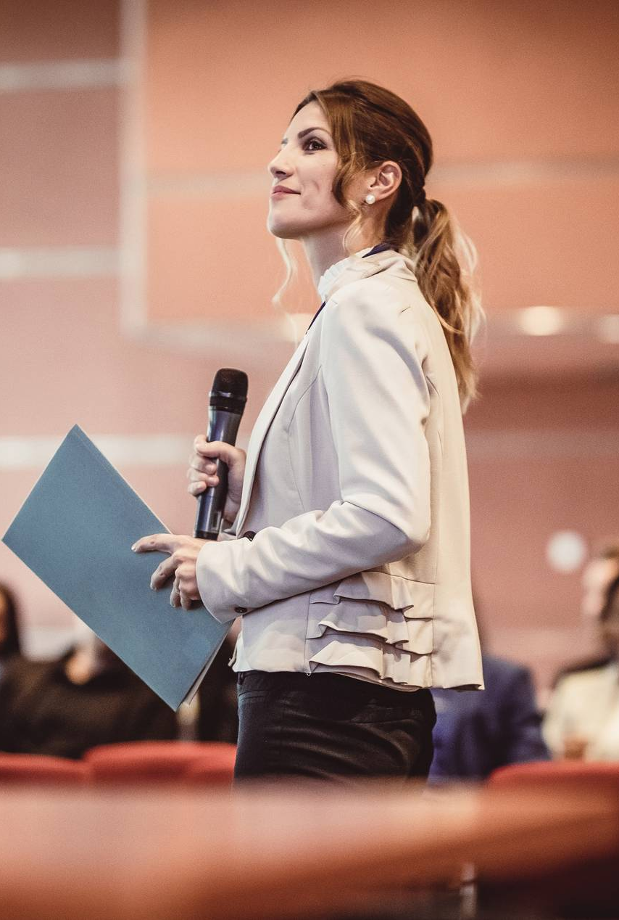
Overcoming nervousness
Confidence-building strategies

Slide 5
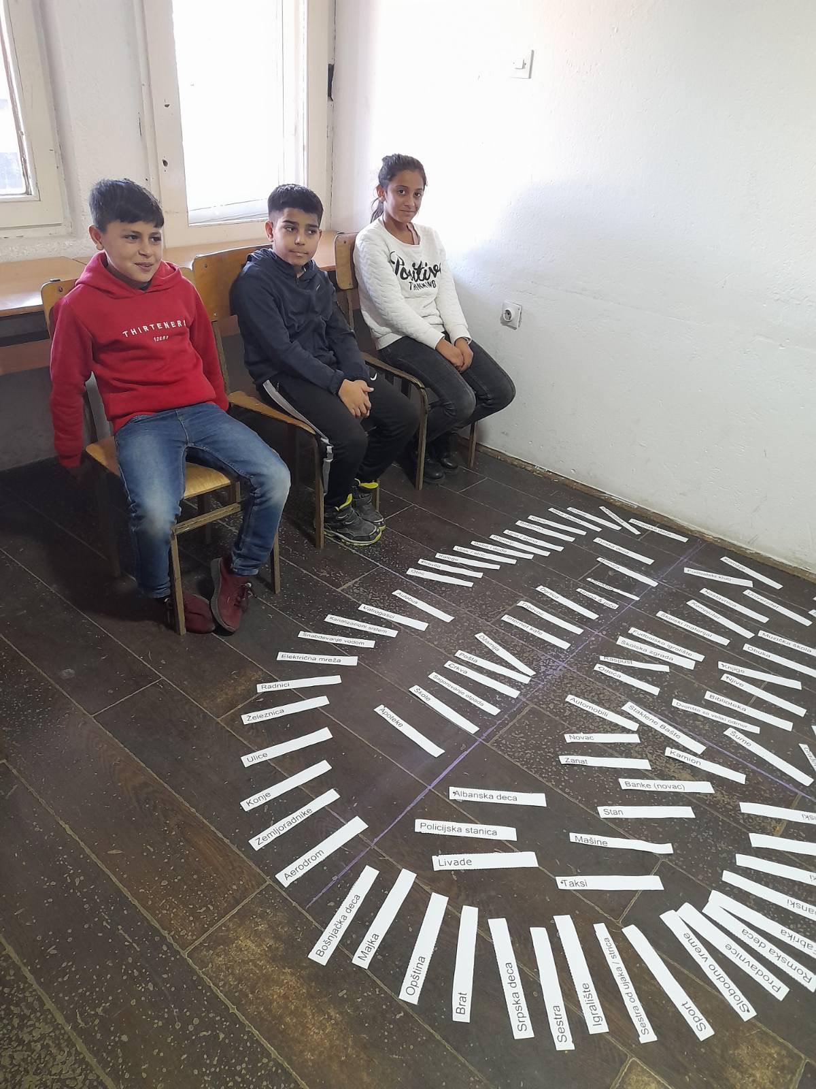
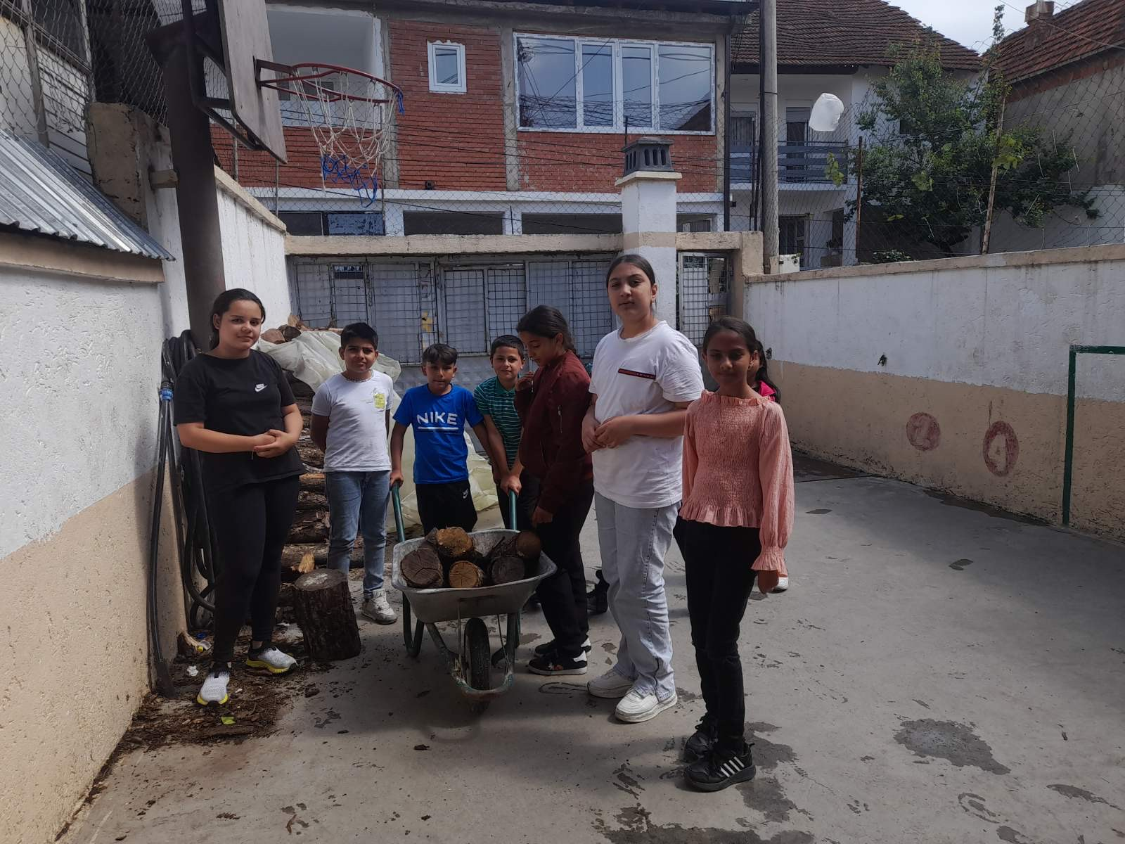
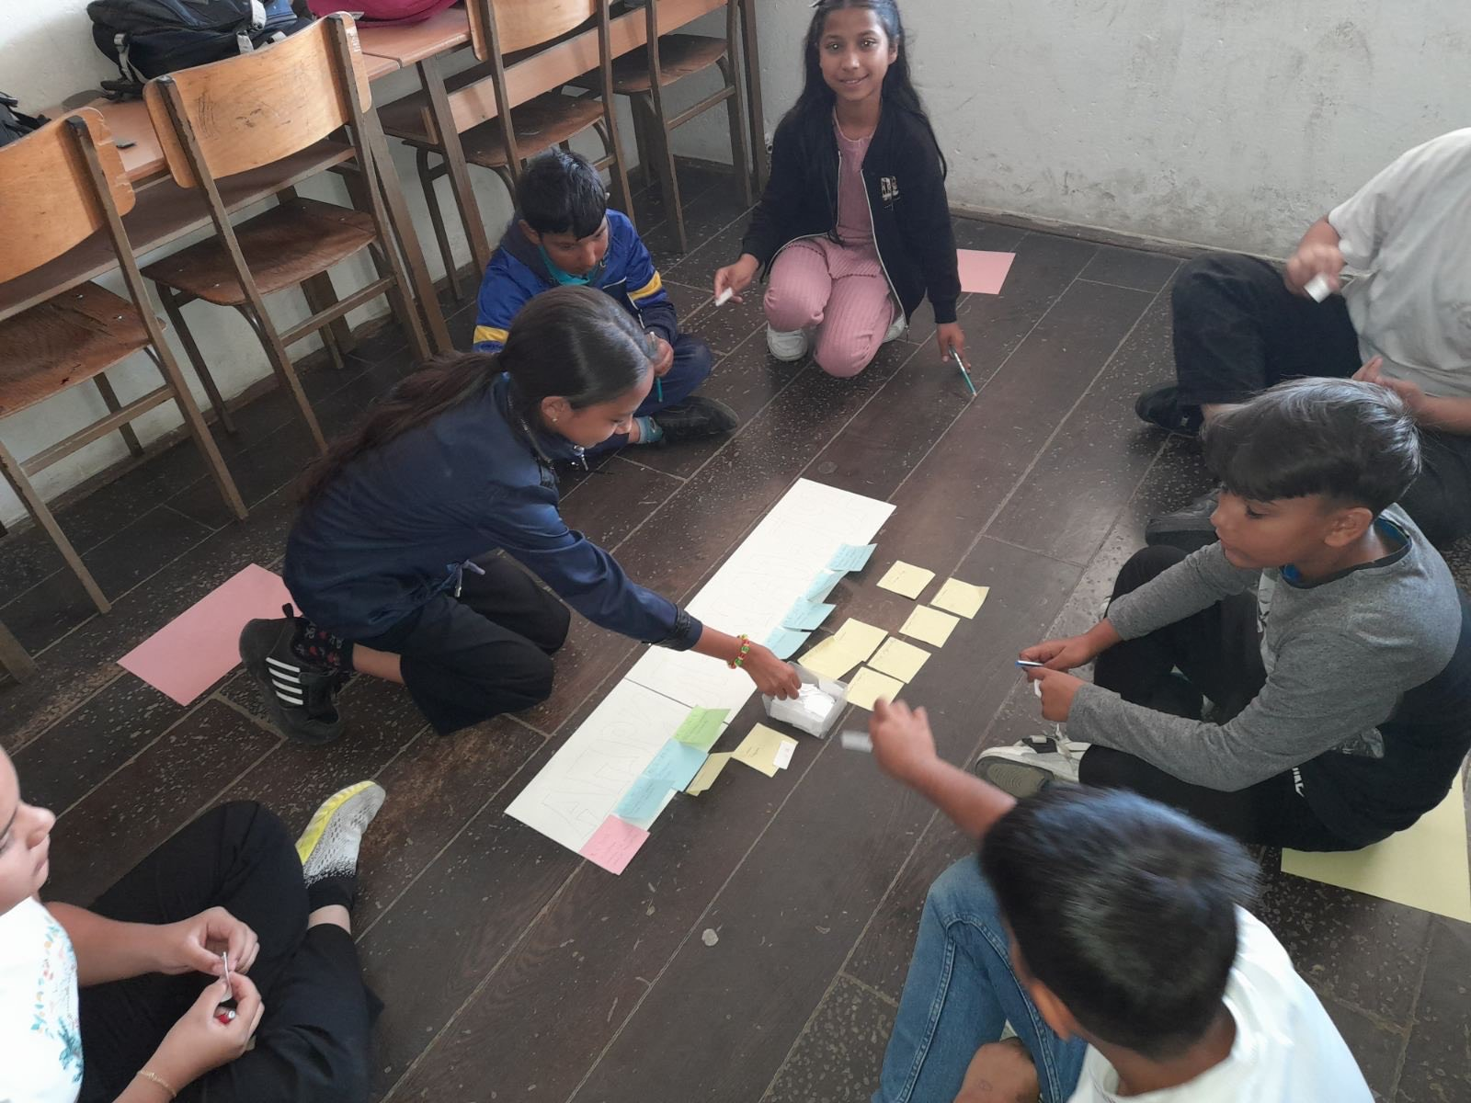
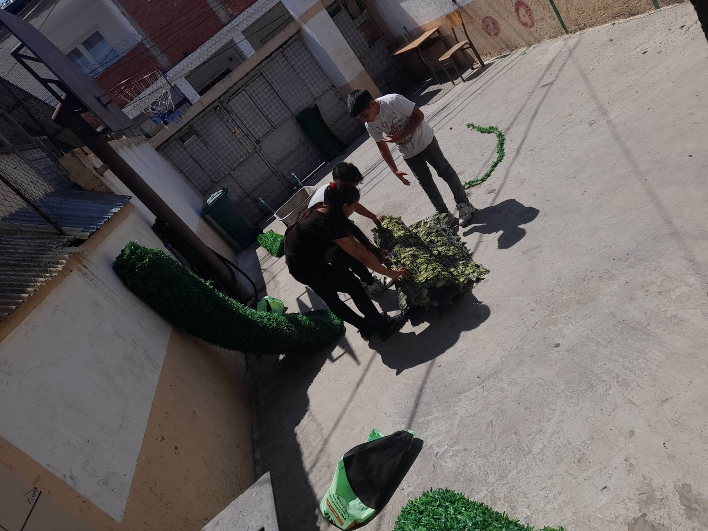
Engaging the audience
Make eye contact with your audience to create a sense of intimacy and involvement
Weave relatable stories into your presentation using narratives that make your message memorable and impactful
Encourage questions and provide thoughtful responses to enhance audience participation
Use live polls or surveys to gather audience opinions, promoting engagement and making sure the audience feel involved

Slide 6
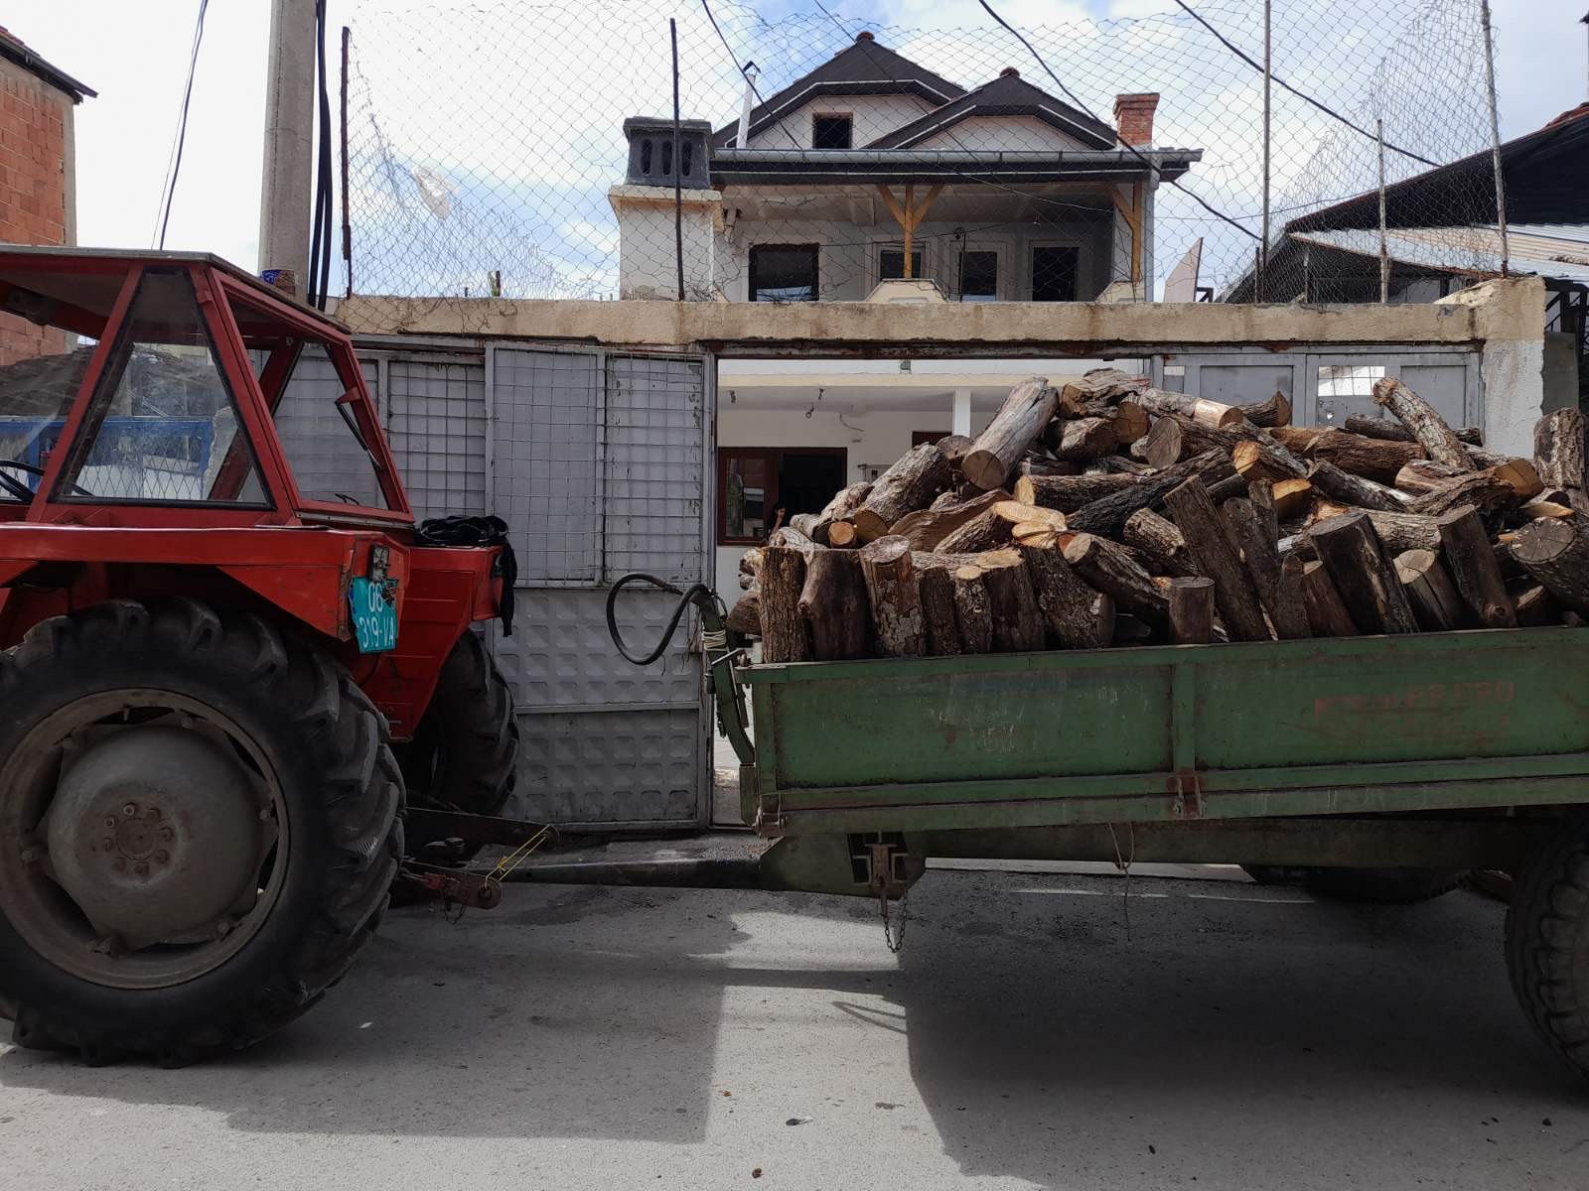
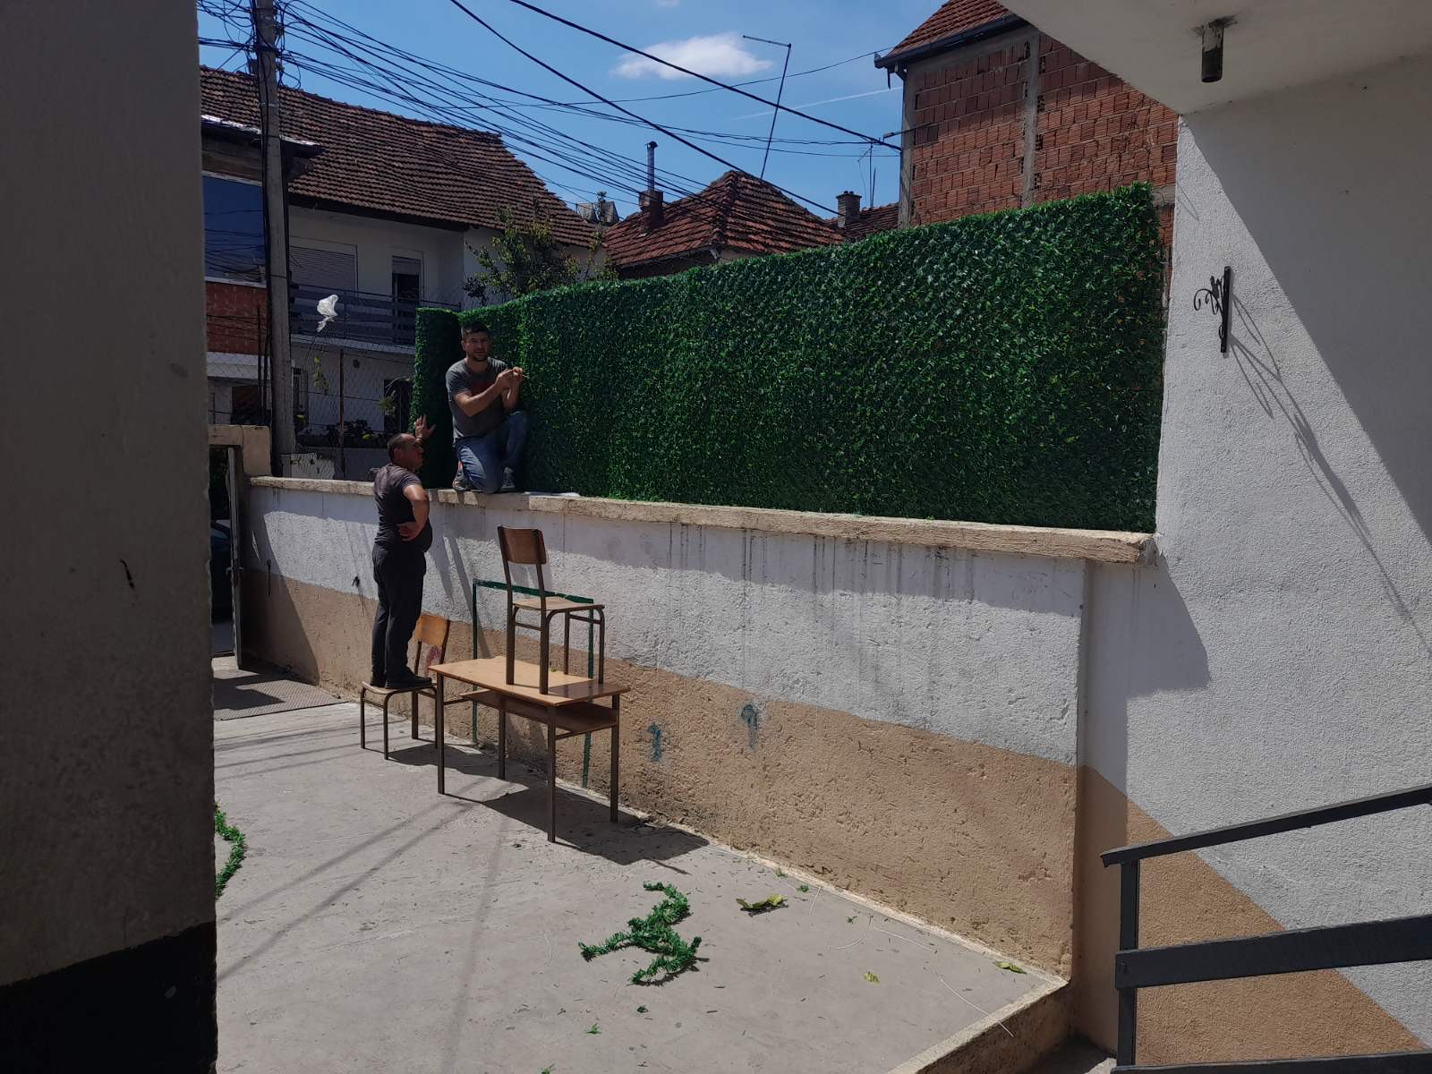
Selecting visual aids
Enhancing your presentation

Slide 7
oVako je pre izgledalo:

Slide 8
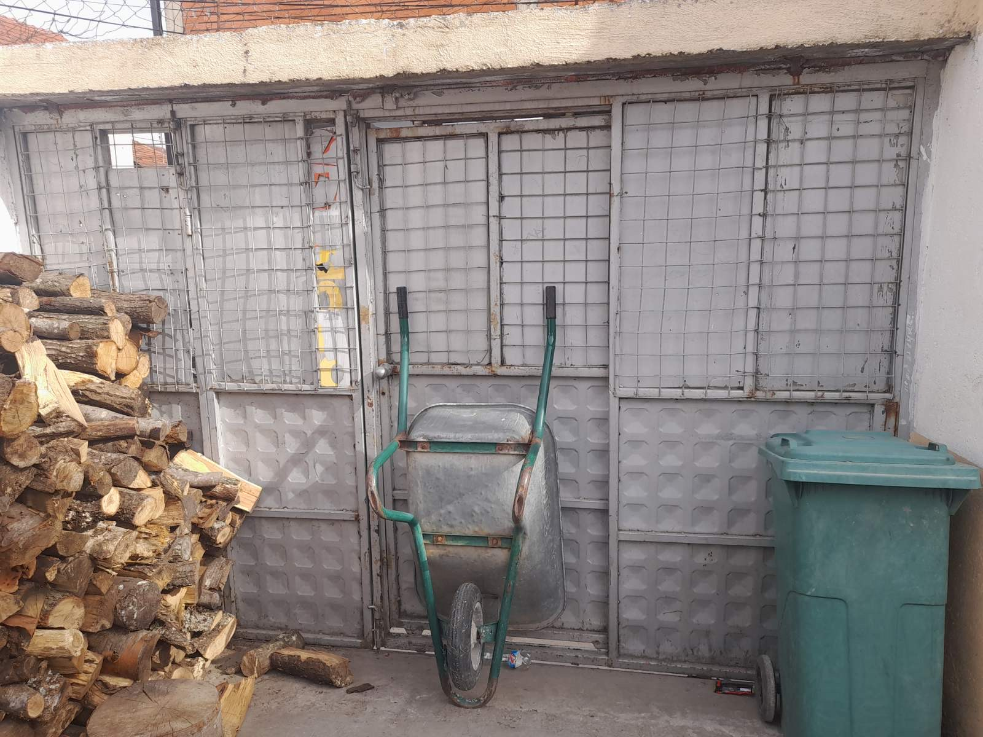

Slide 9
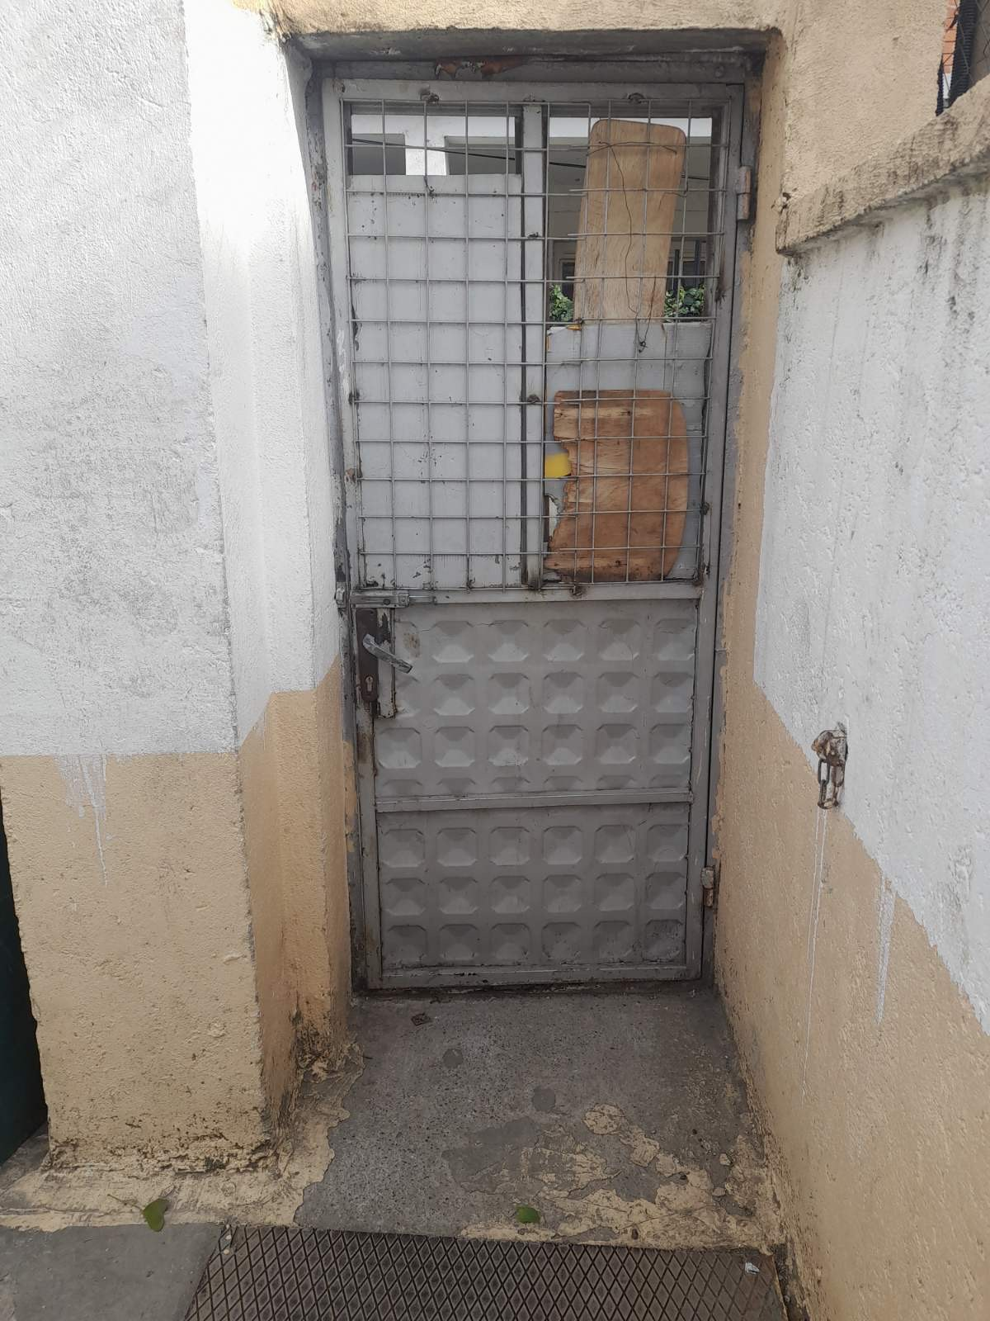

Slide 10
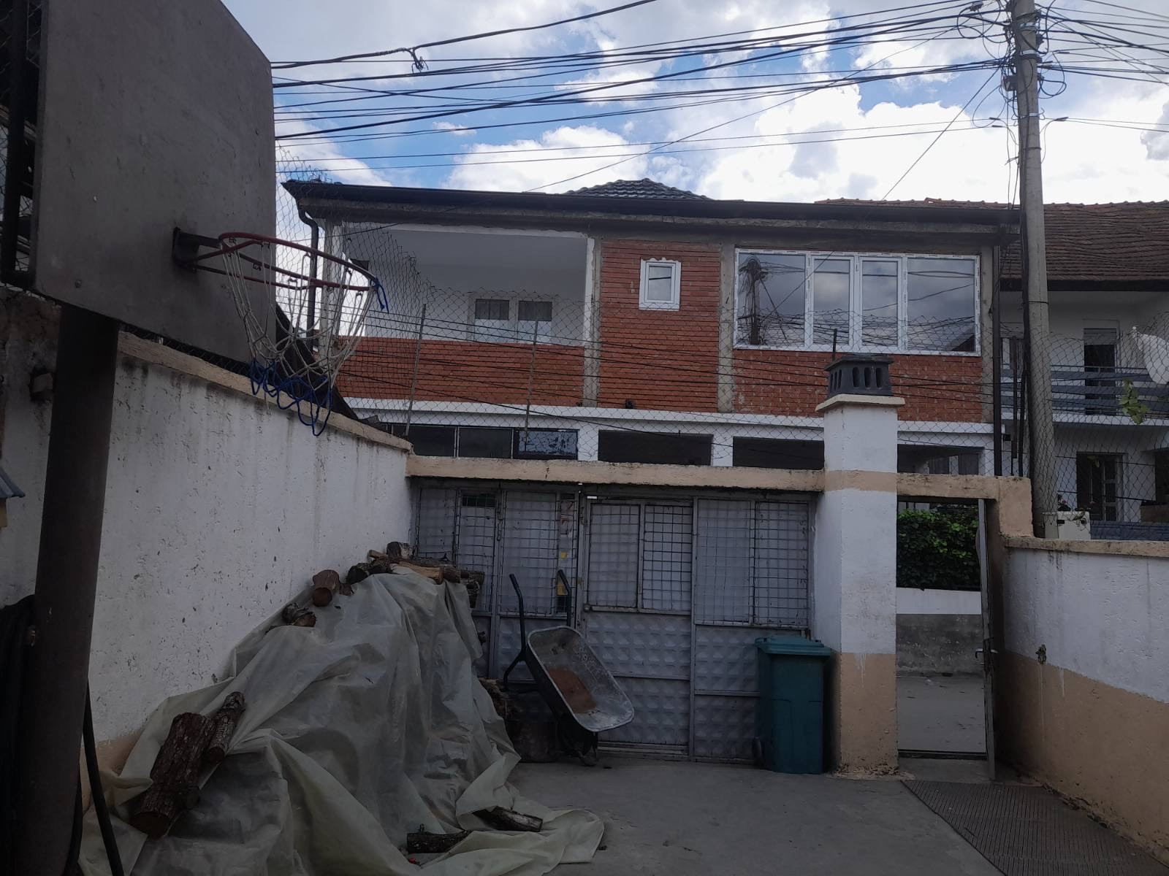

Slide 11
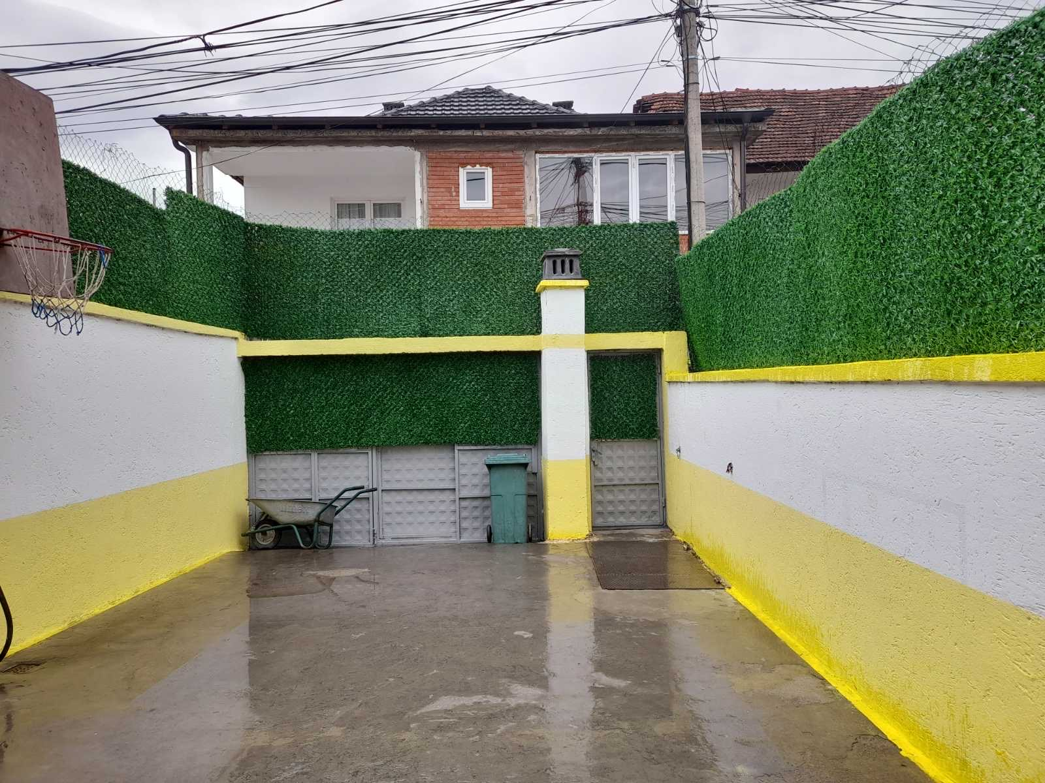
a sad izgleda ovako:

Slide 12
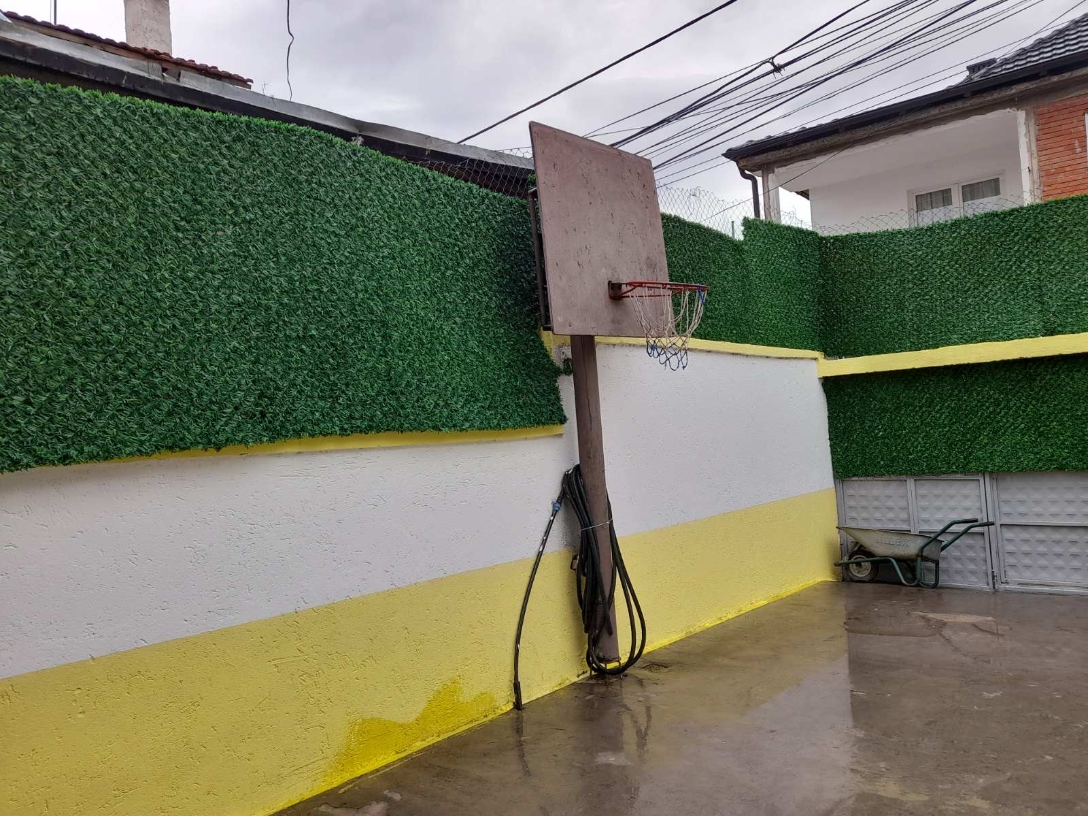
Final tips & takeaways
Consistent rehearsal
  Strengthen your familiarity
Refine delivery style
  Pacing, tone, and emphasis
Timing and transitions
  Aim for seamless, professional delivery
Practice audience
  Enlist colleagues to listen & provide feedback
Seek feedback
Reflect on performance
Explore new techniques
Set personal goals
Iterate and adapt

Slide 14
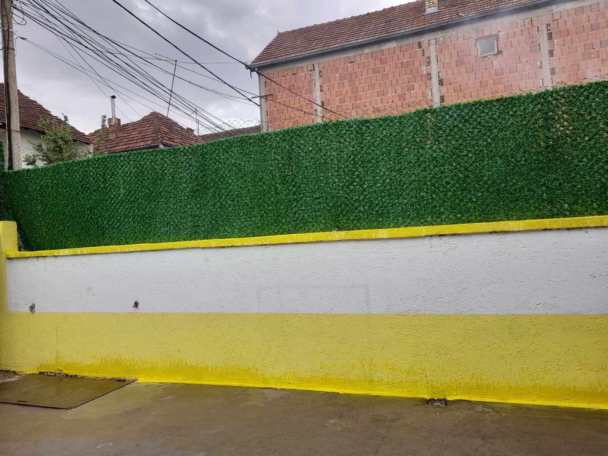
Speaking engagement metrics
Impact factor | Measurement | Target | Achieved
Audience interaction | Percentage (%) | 85 | 88
Knowledge retention | Percentage (%) | 75 | 80
Post-presentation surveys | Average rating | 4.2 | 4.5
Referral rate | Percentage (%) | 10 | 12
Collaboration opportunities | # of opportunities | 8 | 10

Slide 16
Deo atmosfere sa otvaranja projekta:

Slide 17
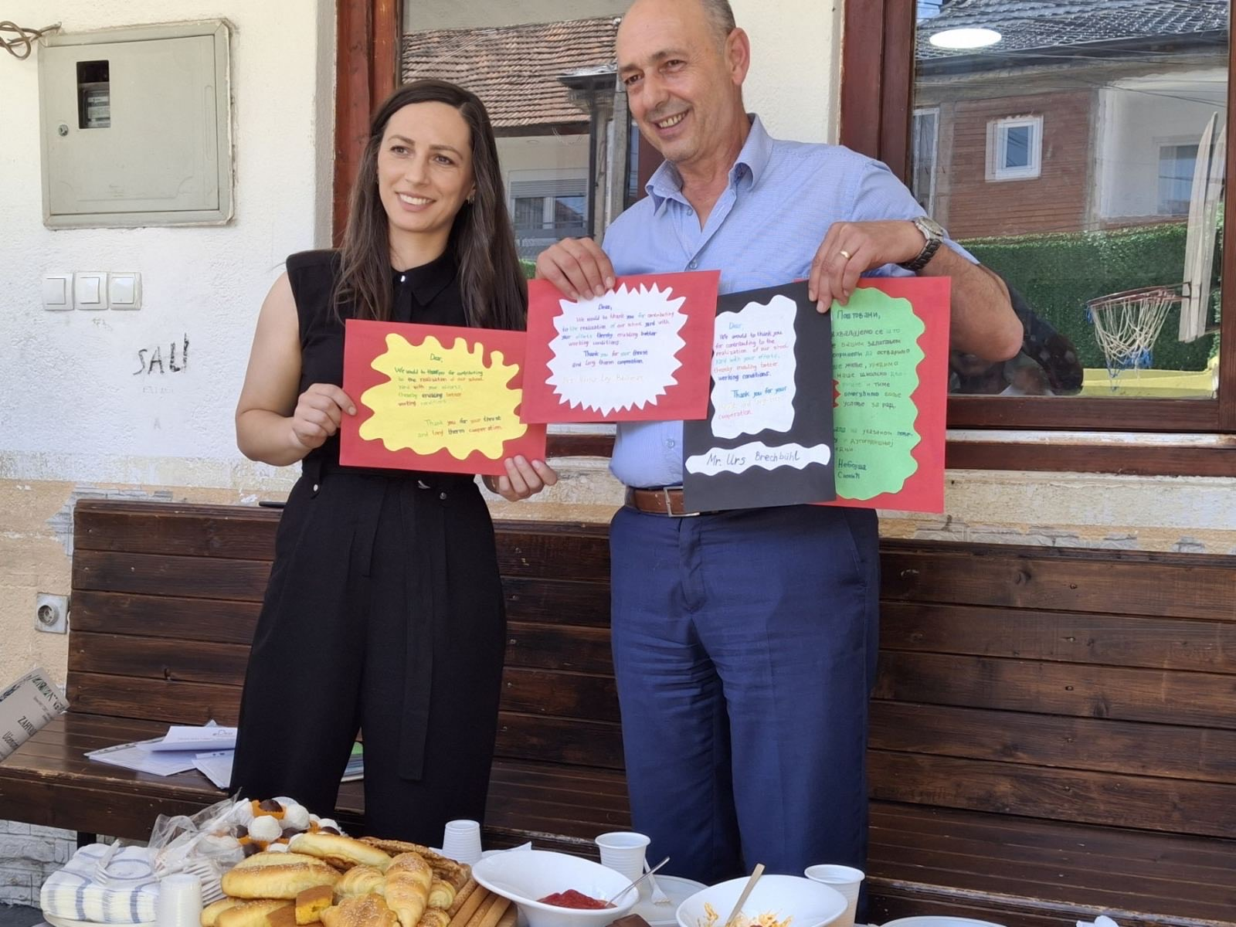

Slide 18
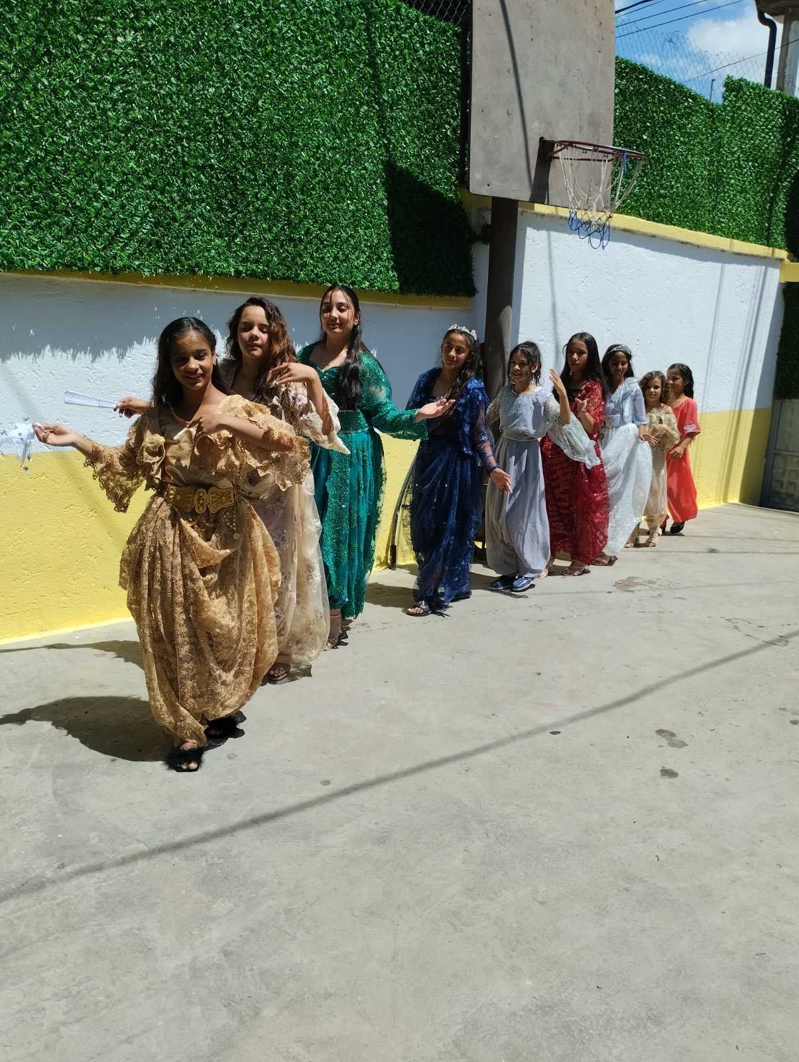

Slide 19
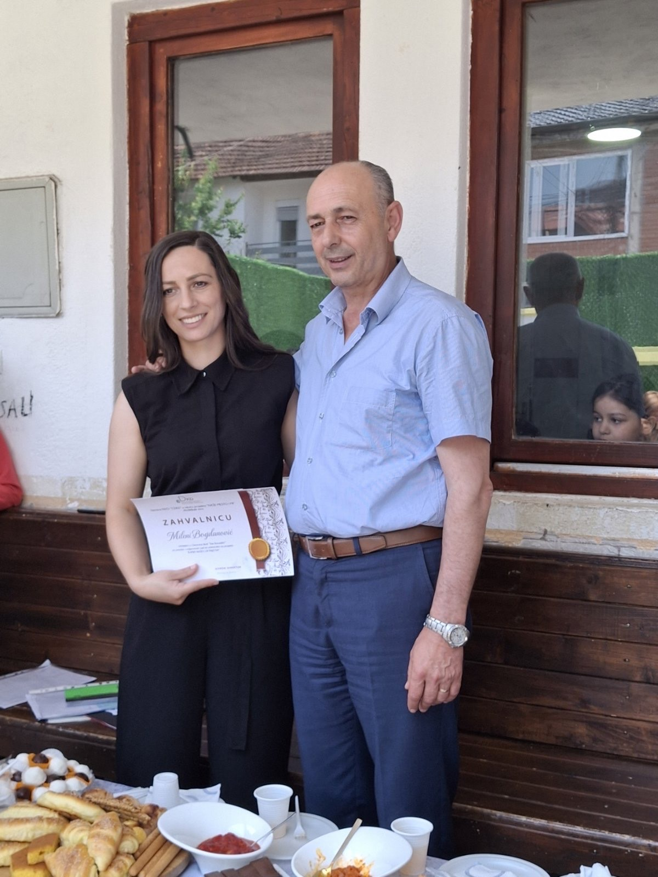

Slide 20
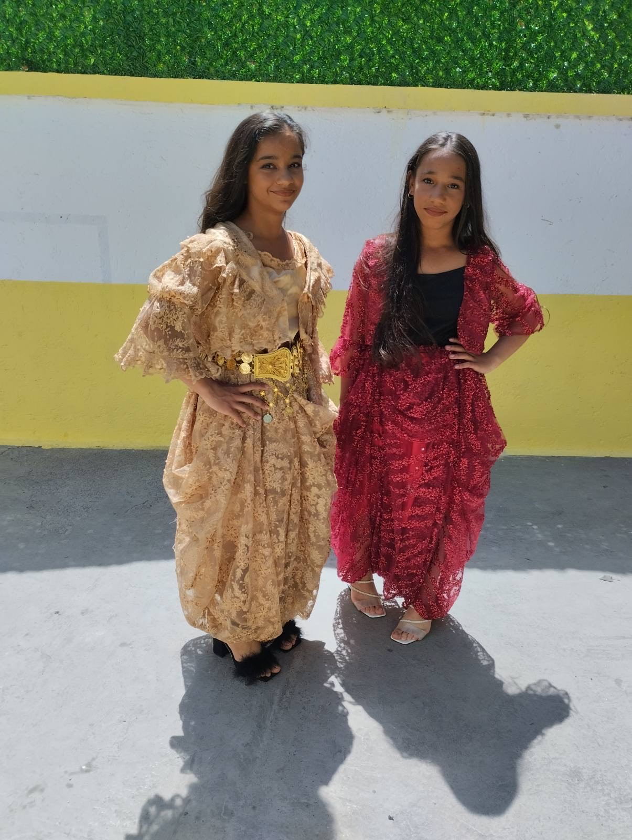
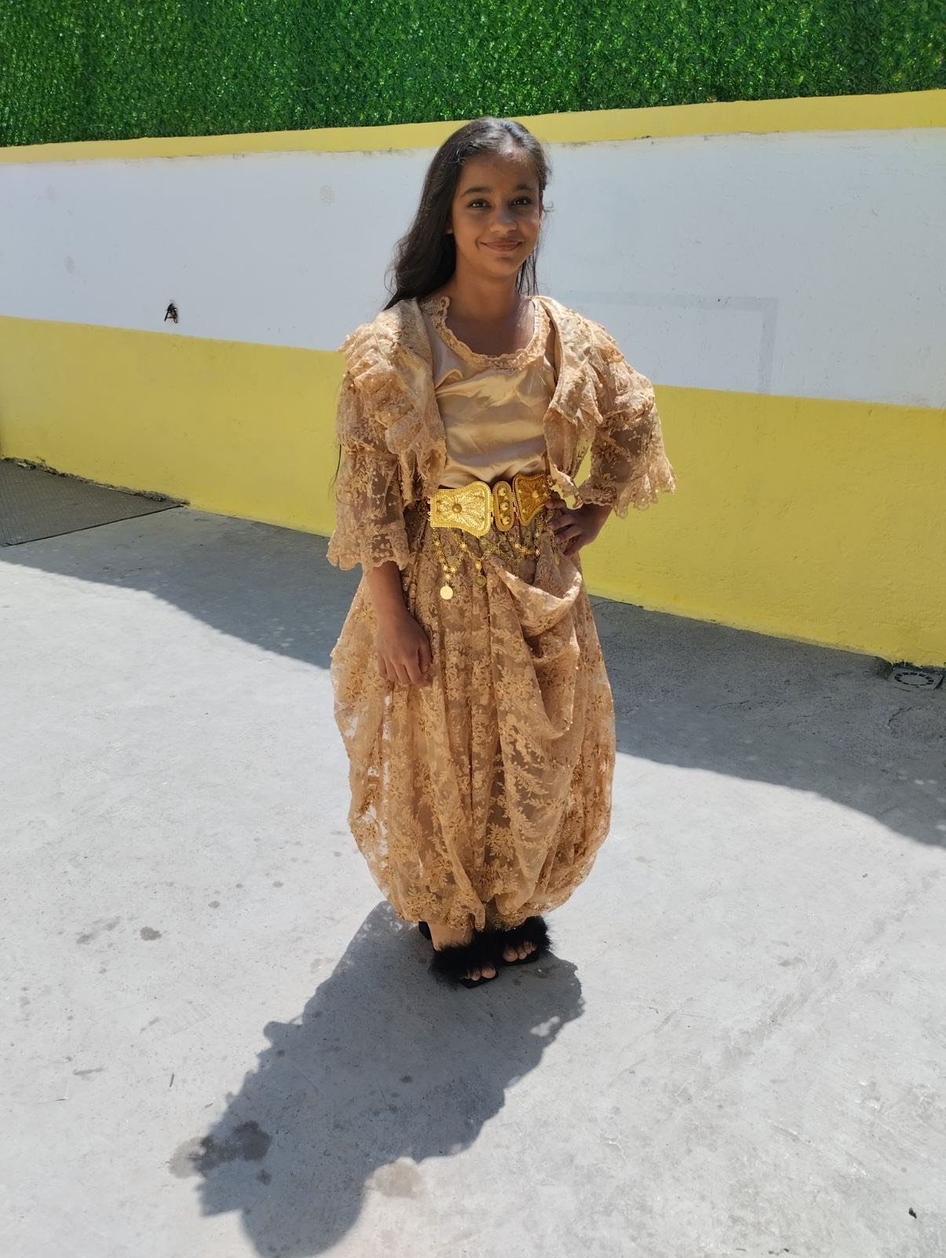

Slide 21
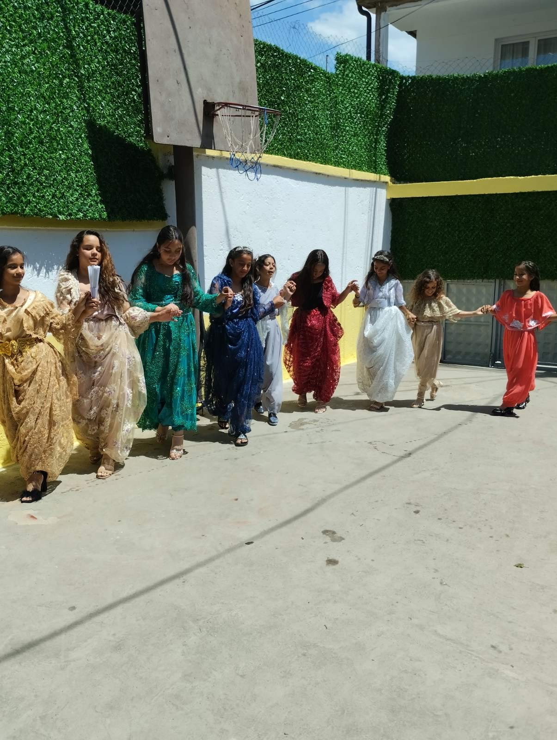
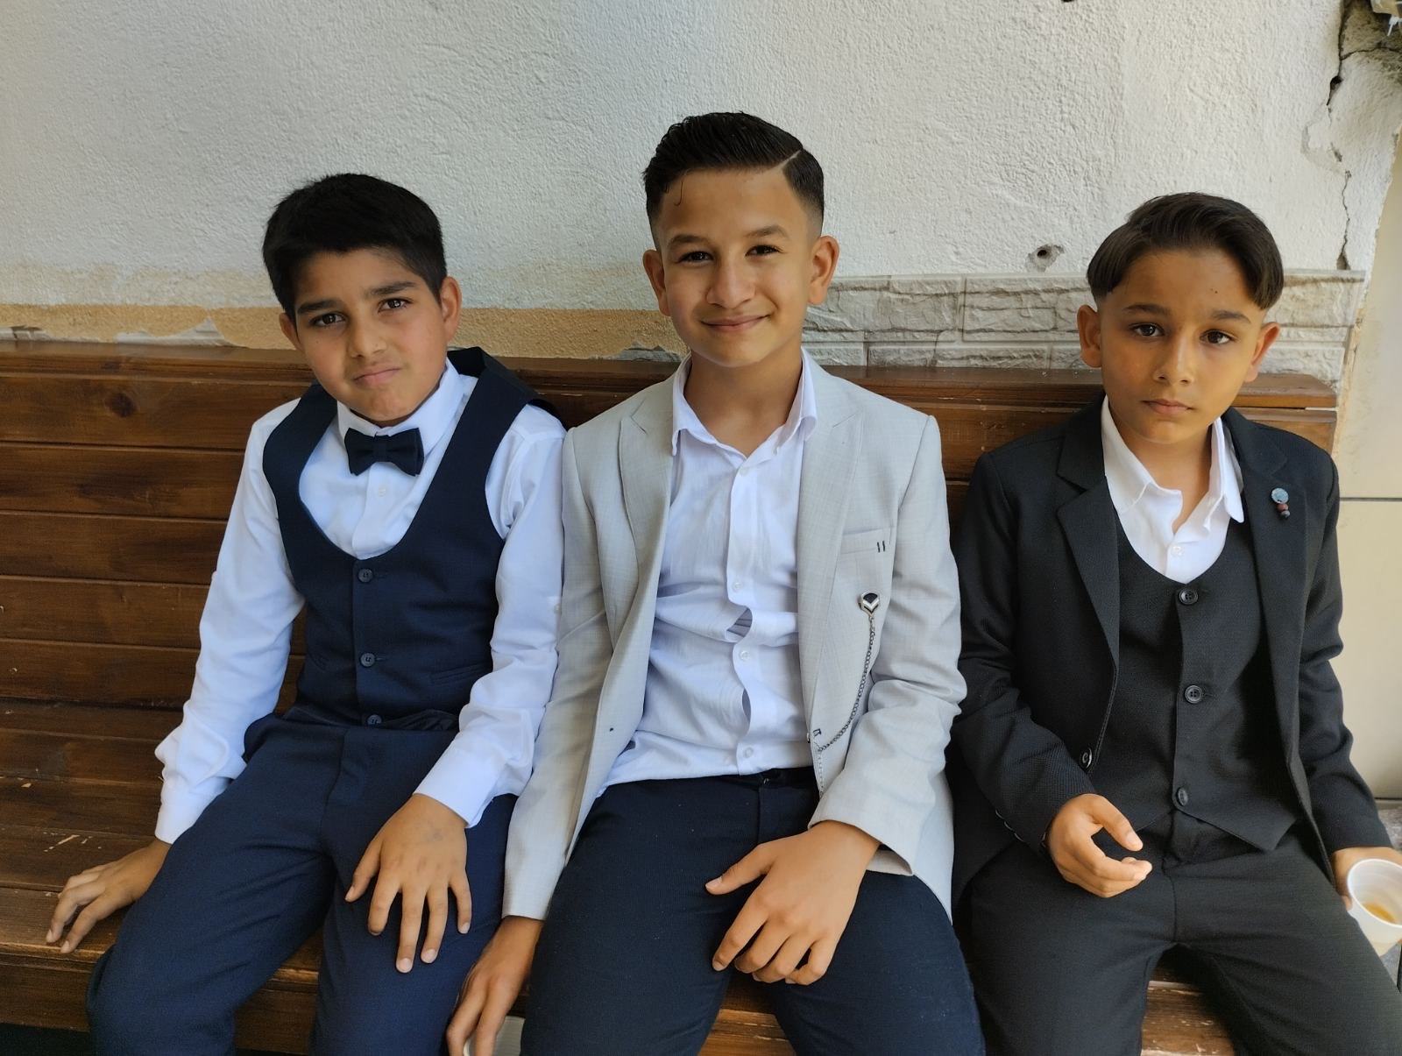

Slide 23
Fotografisanje u novom ruhu:

Slide 24
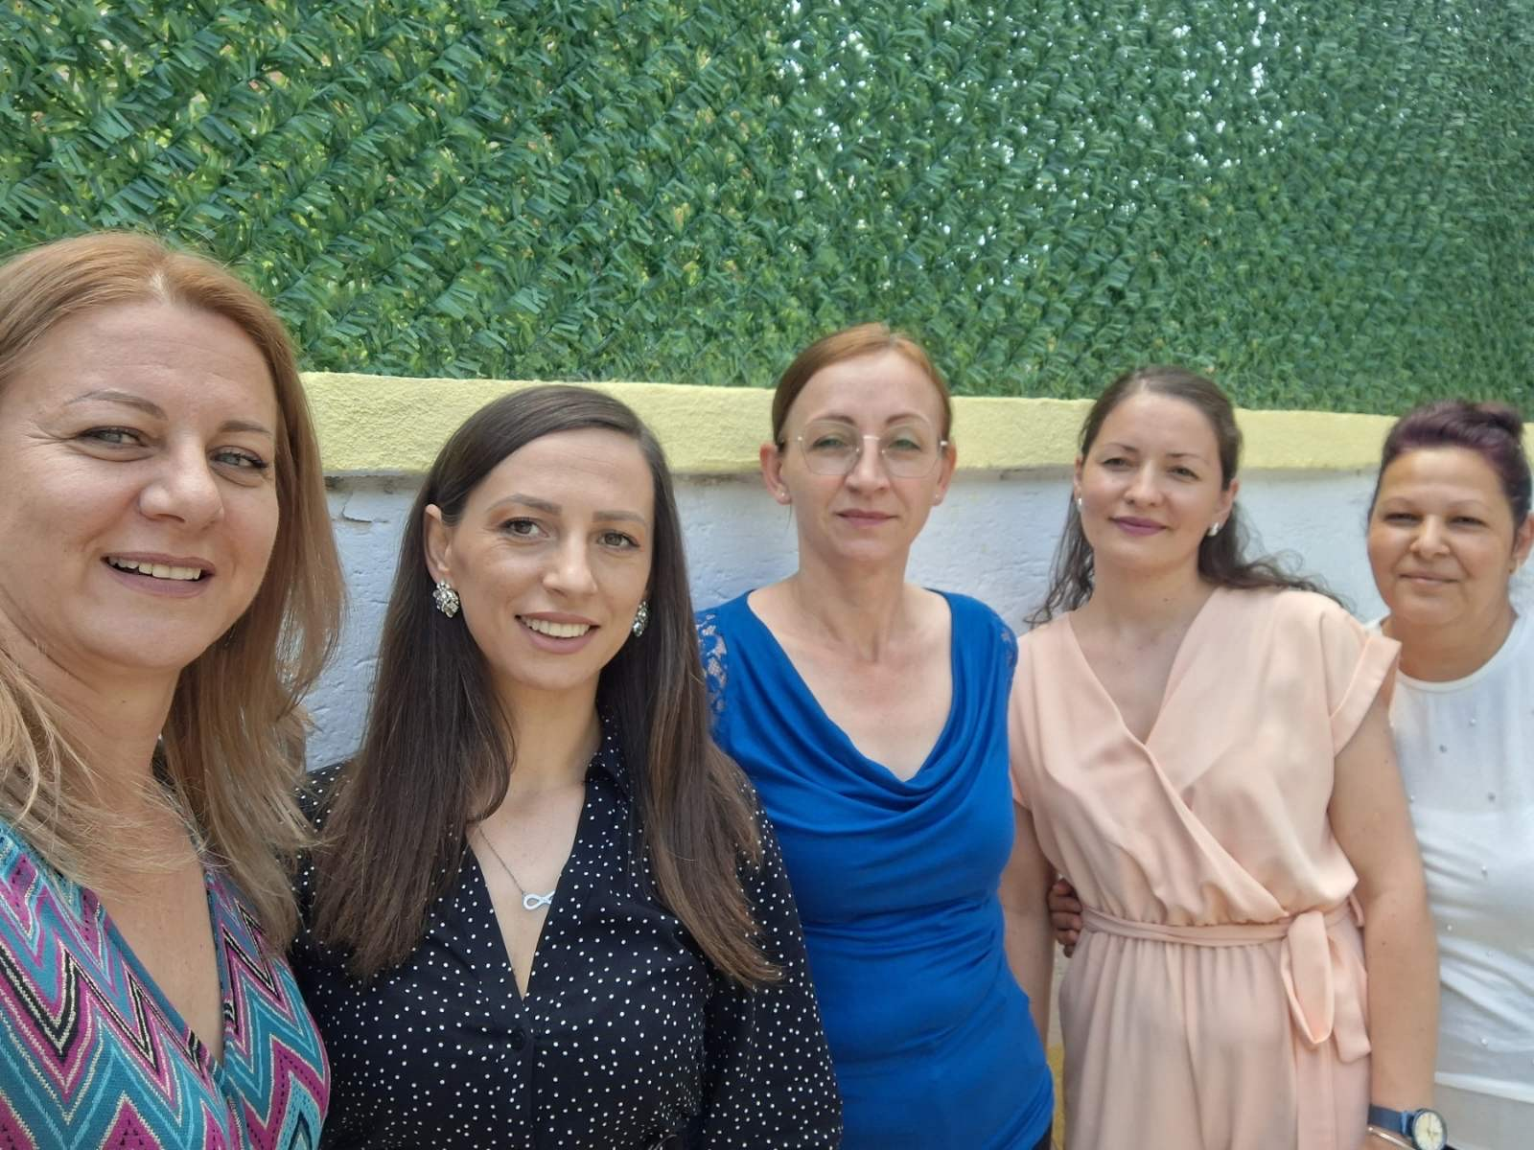

Slide 25
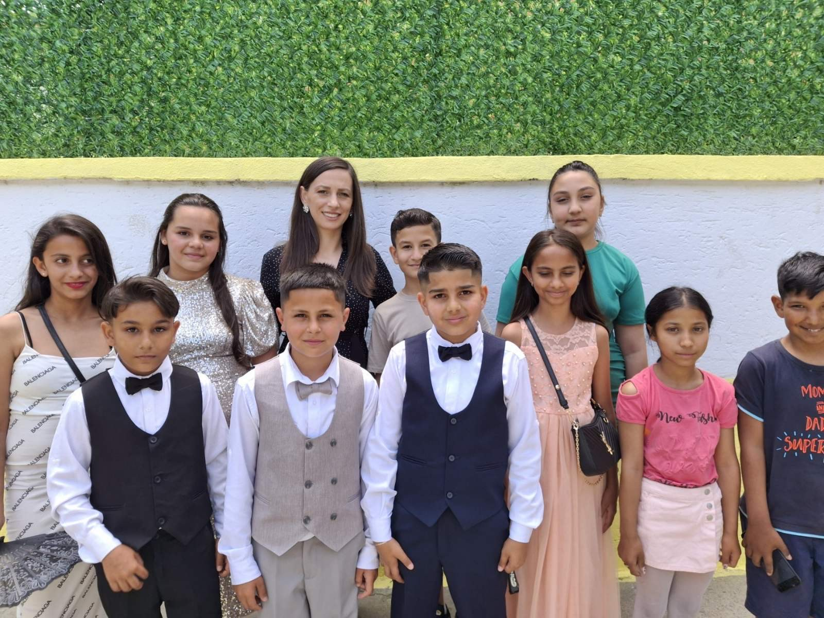

Slide 26
Hvala puno na ukazanom poverenju, jer uz vasu pomoc nasa skola izgleda sve lepse!
izdvojeno odeljenje Ivo Lola Ribar, ucenici IV/4 I ucteljica Milena!

